Slide 1
CAD
Please feel free to choose the design of slides, which is comfortable for you
PI – Prof Michael Yong Zhao
Co-PI: Dr Sholpan Sumbekova

Slide 2
General information
To develop reliable numerical tool to facilitate the cardiosurgents with the prognosis of CAD affected arteries
To produce the cutting-edge tool to obtain the numerical prognosis based on CT images
24 months
$150000

Slide 3
Unmet Need (i.e. What is the problem?)
Projects should be driven by the need for a solution that solves a problem or frustration in the market. What problem are you trying to solve?
Overall, what is the gap in current solutions? (i.e. too expensive, too time consuming, not adequately addressing the need, etc.)
The unmet need should be crystallized into a short statement. It should be clear, succinct, compelling, and memorable.

Slide 4
Market analysis
What is the addressable market size?
Market sizing and landscape: your market is NOT the total market. Identify your market segments.
Focus in on the market that you will go after first.

Slide 5
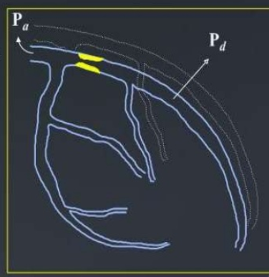
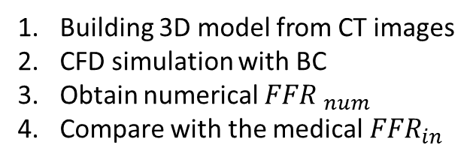
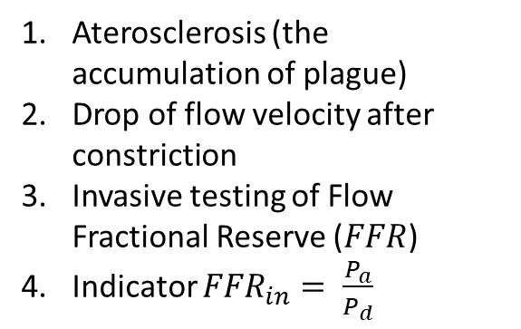
Concept of the Project
Medical Procedure
Aterosclerosis (the accumulation of plague)
Drop of flow velocity after constriction
Invasive testing of Flow Fractional Reserve ($FFR$)
Indicator ${FFR}_{in}= \frac{P_{a}}{P_{d}}$
Numerical Procedure
Building 3D model from CT images
CFD simulation with BC
Obtain numerical ${FFR }_{num}$
Compare with the medical${ FFR}_{in}$
Schematic of CAD affected arteries

Slide 6
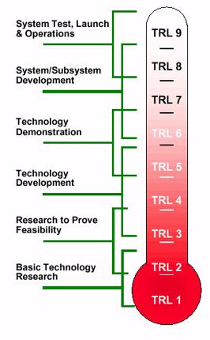
Level of readiness

Slide 7
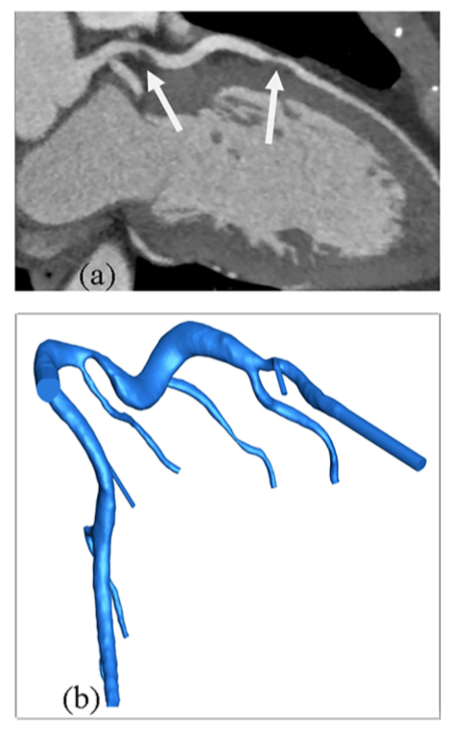
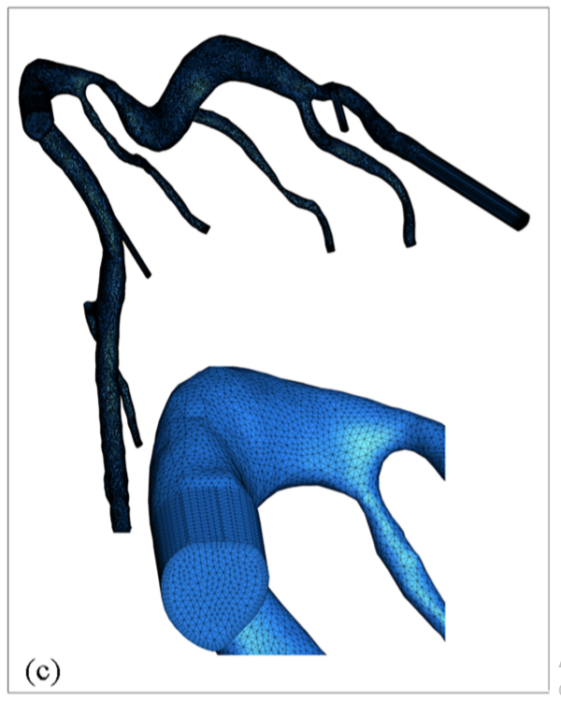
CT scans and 3D Model

Slide 8
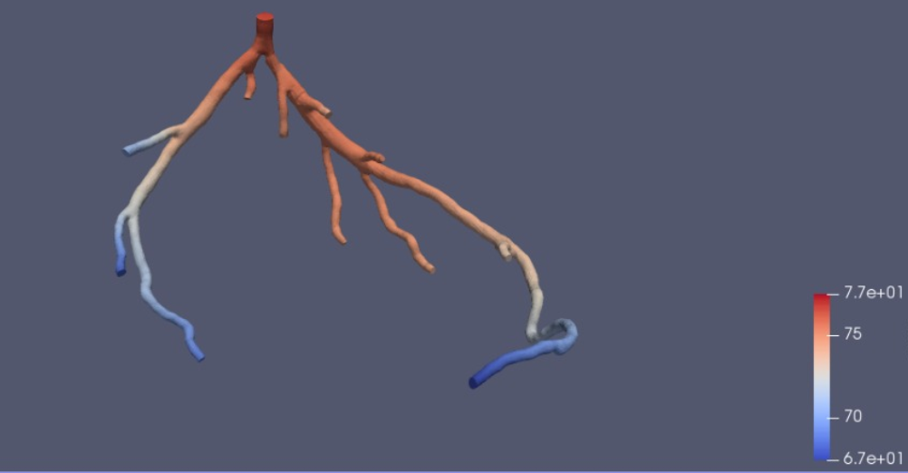
Simulation
Computational Fluid Dynamics simulation of the blood flows gives us a detailed pressure and velocity distribution
Pressure distribution obtained by the free software Simvascular

Slide 9
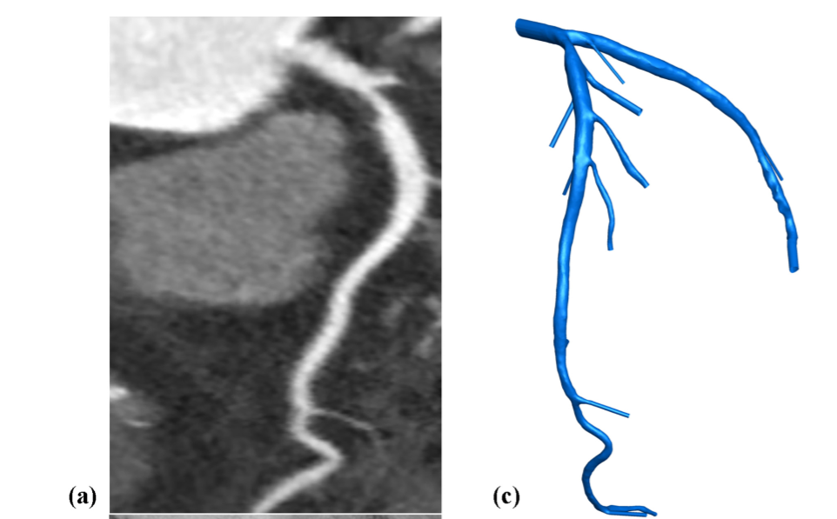
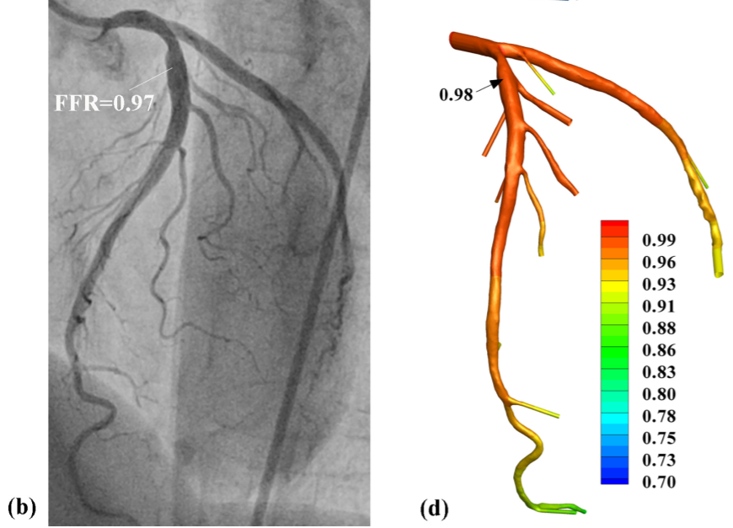
Patient 1
CT image
3D model built and meshed
Angiography Data
Result of FFR computed

Slide 10
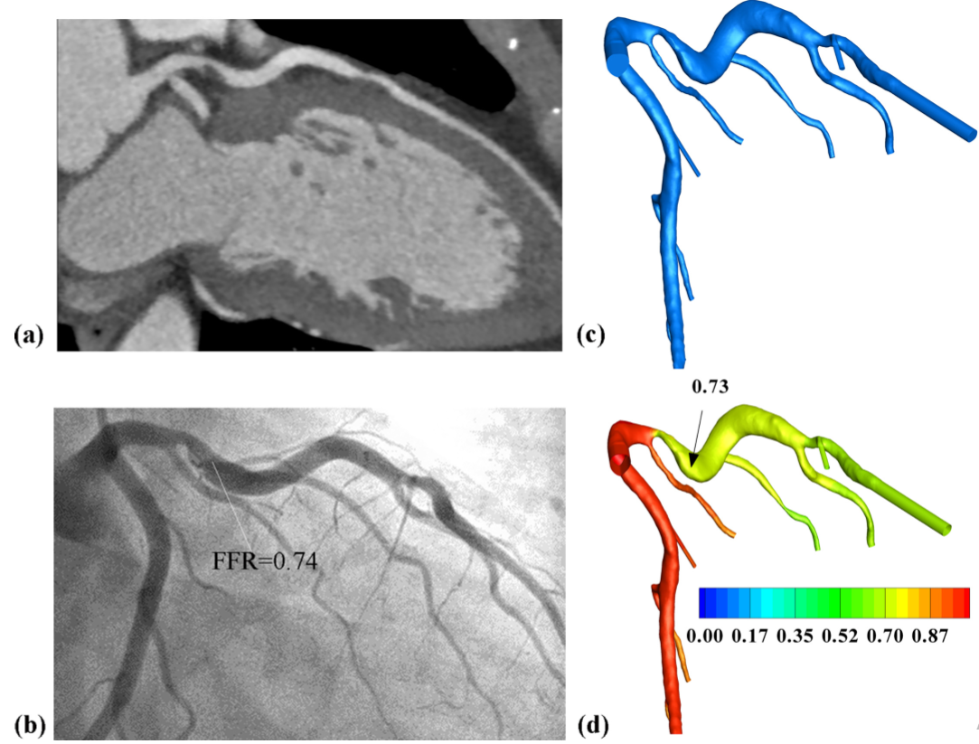
Patient 2
a. CT scans, b. 3D model, c. angiography data, d. simulation result

Slide 11
Intellectual Property Portfolio
What is the potential intellectual property?
Have patents been filed? If so, when and where were they filed? What is the current status of the filings?

Slide 12
Business Model (i.e. How will you generate revenues?)

Slide 13
Team
Prof Michael Yong Zhao – PI
Dr Sholpan Sumbekova – Co-PI
Dr Tairkhan Dautov – Vice-President National Cardiac Centre
Dr Marat Sharipov – Cardiologue, National Cardiac Centre
Torybek Kezhekhanov – 3rd year MAE Department

Slide 14
Thank You !

